Slide 1
Team #2
By Alexandra, Hien, Charles, Carter, Jacob, Roselis and Jennifer

Slide 2
Sources
http://www.youtube.com/watch?feature=endscreen&NR=1&v=Y_dCc-9pEPM
http://cdn01.dailycaller.com/wp-content/uploads/2011/04/instant-regina-george.jpg
http://www.usc.edu.au/university/Library/Tutorials/OnlineUndergrad/PlagiarismReferencing/HowCommitted.htm
http://mediamatters.org/research/2007/04/04/imus-called-womens-basketball-team-nappy-headed/138497
http://www.tmz.com/2006/11/20/kramers-racist-tirade-caught-on-tape/
http://www.people.com/people/article/0,,1561377,00.html
http://www.nypost.com/p/news/local/oh_what_boob_EC1P3M9HhUkookGs8sMXlM
http://www.aresearchguide.com/6plagiar.html
http://www.plagiarism.org/plag_article_educational_tips_on_plagiarism_prevention.html
http://voices.yahoo.com/ethnocentrism-intercultural-communication-1388099.html?cat=72

Slide 3

Self-centrism
Throughout the whole movie, she shows no regards for her friends feelings. She treats them like they are her toys and makes decisions for them and bosses them around. On the surface everyone seems to love her but they all actually can’t stand her. Because of her attitude, her so called “friends” actually dislike her a lot. Everything has to go her way, and even if her best friends already made plans, she would tell them no.

Slide 4

Regina george

Slide 5
Communication and ethnocentrism
What is ethnocentrism?
Judging other people’s cultures by the standard of one’s own culture
Having the sense and feeling of superiority of one’s own culture
One’s culture is thought to be the norm and different cultures are seen as abnormal, wrong, and inferior
Examples:
KKK
Nazis

Slide 6
Consequences of Ethnocentrism Relating to Communication
Has negative consequences in communicating and is a great barrier in intercultural communication
Causes people to base their social interactions on their own cultural norms which leads to misunderstandings and miscommunication
Stereotypes
The audience gets treated inferior which increases the distance between them and the speaker

Slide 7
How to avoid it
One needs to become aware of other people’s cultural values, norms, perceptions, and beliefs
Acknowledge that you don’t know norms and values of other cultures and increase your understanding about them
Internal values like being respectful, being thoughtful of others, and not doing to others what one wouldn’t like done to them

Slide 8
Deliberate Plagiarism
getting someone to write your research for you
stealing another person's research
buying someone else's research
deliberately copying sections of another person's work into your paper without acknowledging the source
using three or more words that are yours and not citing them

Slide 9
Easy way to cite information
http://www.citefast.com/
http://howtociteaspeech.blogspot.com/

Slide 10
How to cite a speech using APA format
How to Cite a Speech Using APA Format
Provide the name of speaker.
(Year, month).
Speech's Title.
Speech presented at location of speech.
City, State.
Simpleton, J. (2009, January). Nationalization of Government. Speech presented at the Preservation of Democracy Society, Knoxville, TN.

Slide 11
Accidental plagiarism
forgetting to put quotation marks around an exact quote from another person's work
forgetting to enter citations after paraphrasing
incorrectly referencing sources of information

Slide 12
Paraphrasing
Use a signal or identifying phrase that tells who and what you are paraphrasing
Use the same ideas as in the original text
Use your own words when phrasing. In most cases, avoid using any of the same
Wording that the author used unless you put a key term in quotation marks.
Add an in text (parenthesis) reference at the end of the paraphrase

Slide 13
Quoting
Definition: Using an authors language word for word.
Use quotation marks around the author’s words.
Use a signal or identifying phrase that tells who and what you are quoting.
Include a citation at the end of your paper.
Ex. "A man who won't die for something, is not fit to live"- (Martin Luther King Jr.)

Slide 14
Summarizing
Definition: Condensing an authors idea to a more brief statement
Use a signal or identifying phrase that tells who and what you are summarizing.
Use a quick description of the main points of the passage.
Use your own words and phrasing. In most cases, avoid using any of the same
wording.
Add an in­ text (parenthesis) reference at the end of the summary.
**Always include a citation at the end of your paper (Work Cited Page)

Slide 15
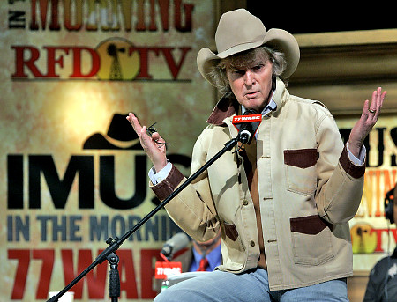
Racial Slurs
April 4th 2007 MSNBC’s Imus in the morning
Bernard McGuirk
Don Imus
Sid Rosenberg filling in for
Chris Carlin
Consequence

Slide 16
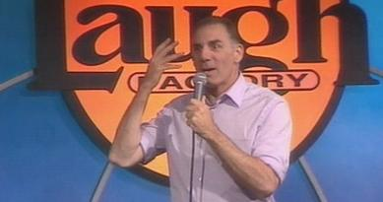
Racial Slurs
Laugh factory West Hollywood
Michael Richards (Kramer from Seinfeld)
Kyle doss and some friends
Apology

Slide 17

Racial Slurs
Hooters in New York,
Places order to go
Gets receipt
Becomes nauseated
lawsuit still being determined
DON’T BE RACIST
Keep your mouth shut
Don’t involve race
Respect others
Golden rule treat people the way you would like to be treated

Slide 18
Thanks for listening! ☺

